Slide 1

Data Base Management

Slide 2

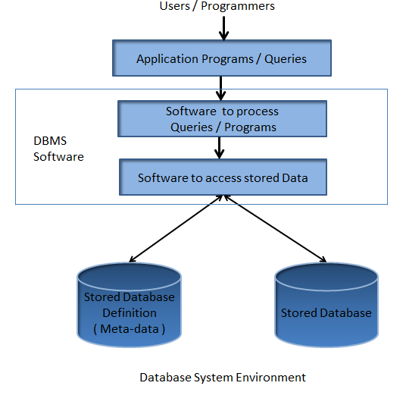
DataBase (DB)
Data Base Management System (DBMS)
A database is an organized collection of structured information/data, typically stored electronically in a computer system
Database management system is a software which is used to manage the database. For example: MySQL, Oracle, etc are a very popular commercial database which is used in different applications.
It provides protection and security to the database. In the case of multiple users, it also maintains data consistency

Slide 3

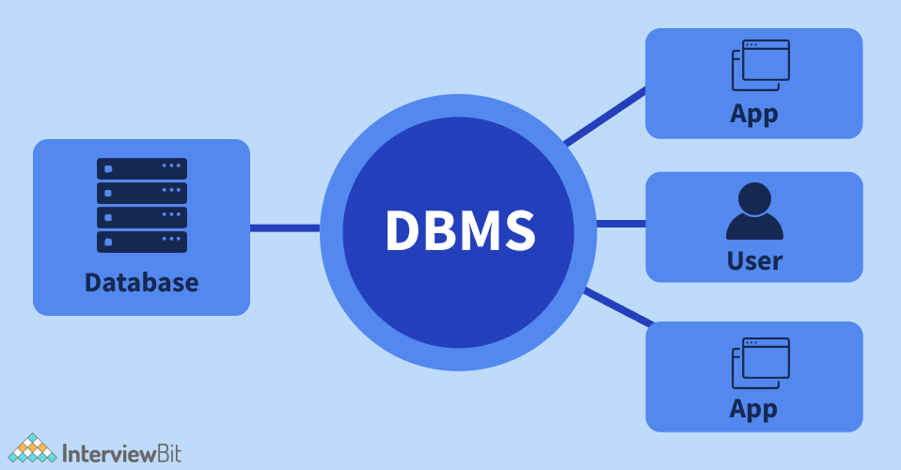

Slide 4
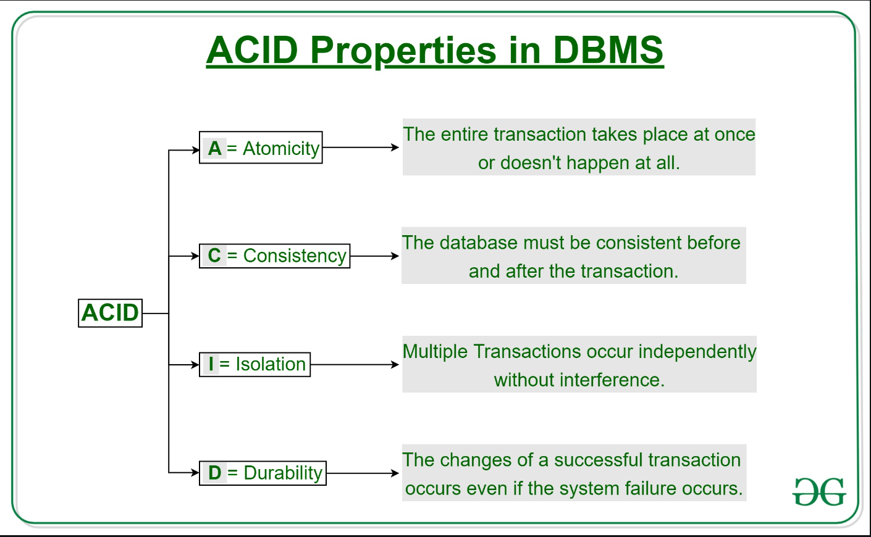

Slide 5
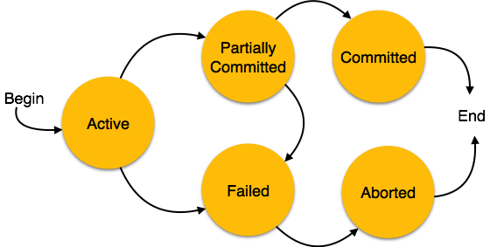
Transaction State

Slide 7

SELECT * FROM Customers
Notes:
https://www.programiz.com/sql/online-compiler/

Slide 8

WHERE conditions
SELECT * FROM Customers WHERE City="Berlin";
SELECT * FROM Customers WHERE City="Berlin" AND Country = "Germany";
SELECT * FROM Customers WHERE City='Berlin' OR City='München';

Slide 9
SELECT * FROM Customers
WHERE last_name like 'D%' OR age IN (22,31,25);
Notes:
https://www.programiz.com/sql/online-compiler/

Slide 10
WHERE conditions
SELECT * FROM Customers WHERE NOT City='Berlin' OR City='München';

Slide 11
Update
UPDATE Customers
SET ContactName = 'affid', City= 'KTM'
WHERE CustomerID = 1;

Slide 12
Delete
DELETE FROM Customers WHERE CustomerName='Alfreds Futterkiste';

Slide 13
JOINS

Slide 14
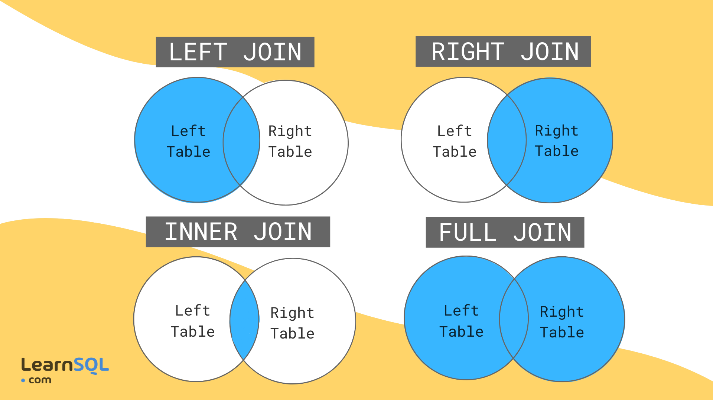

Slide 15
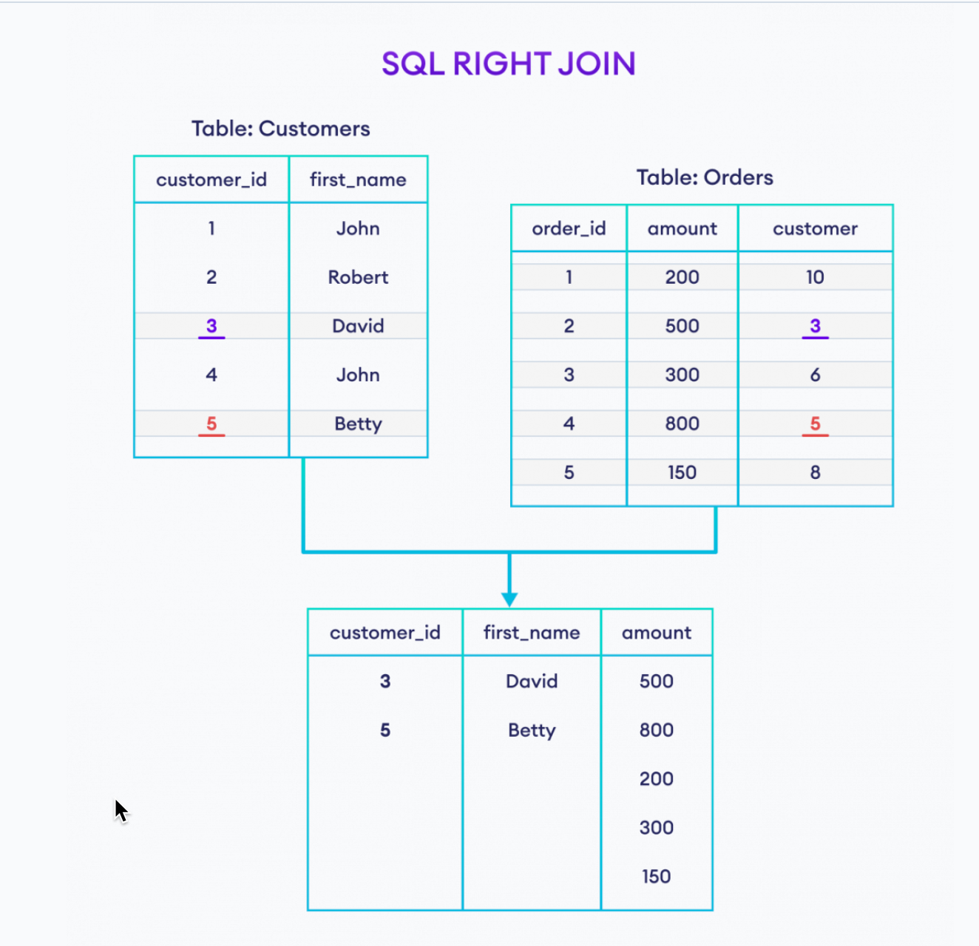

Slide 16
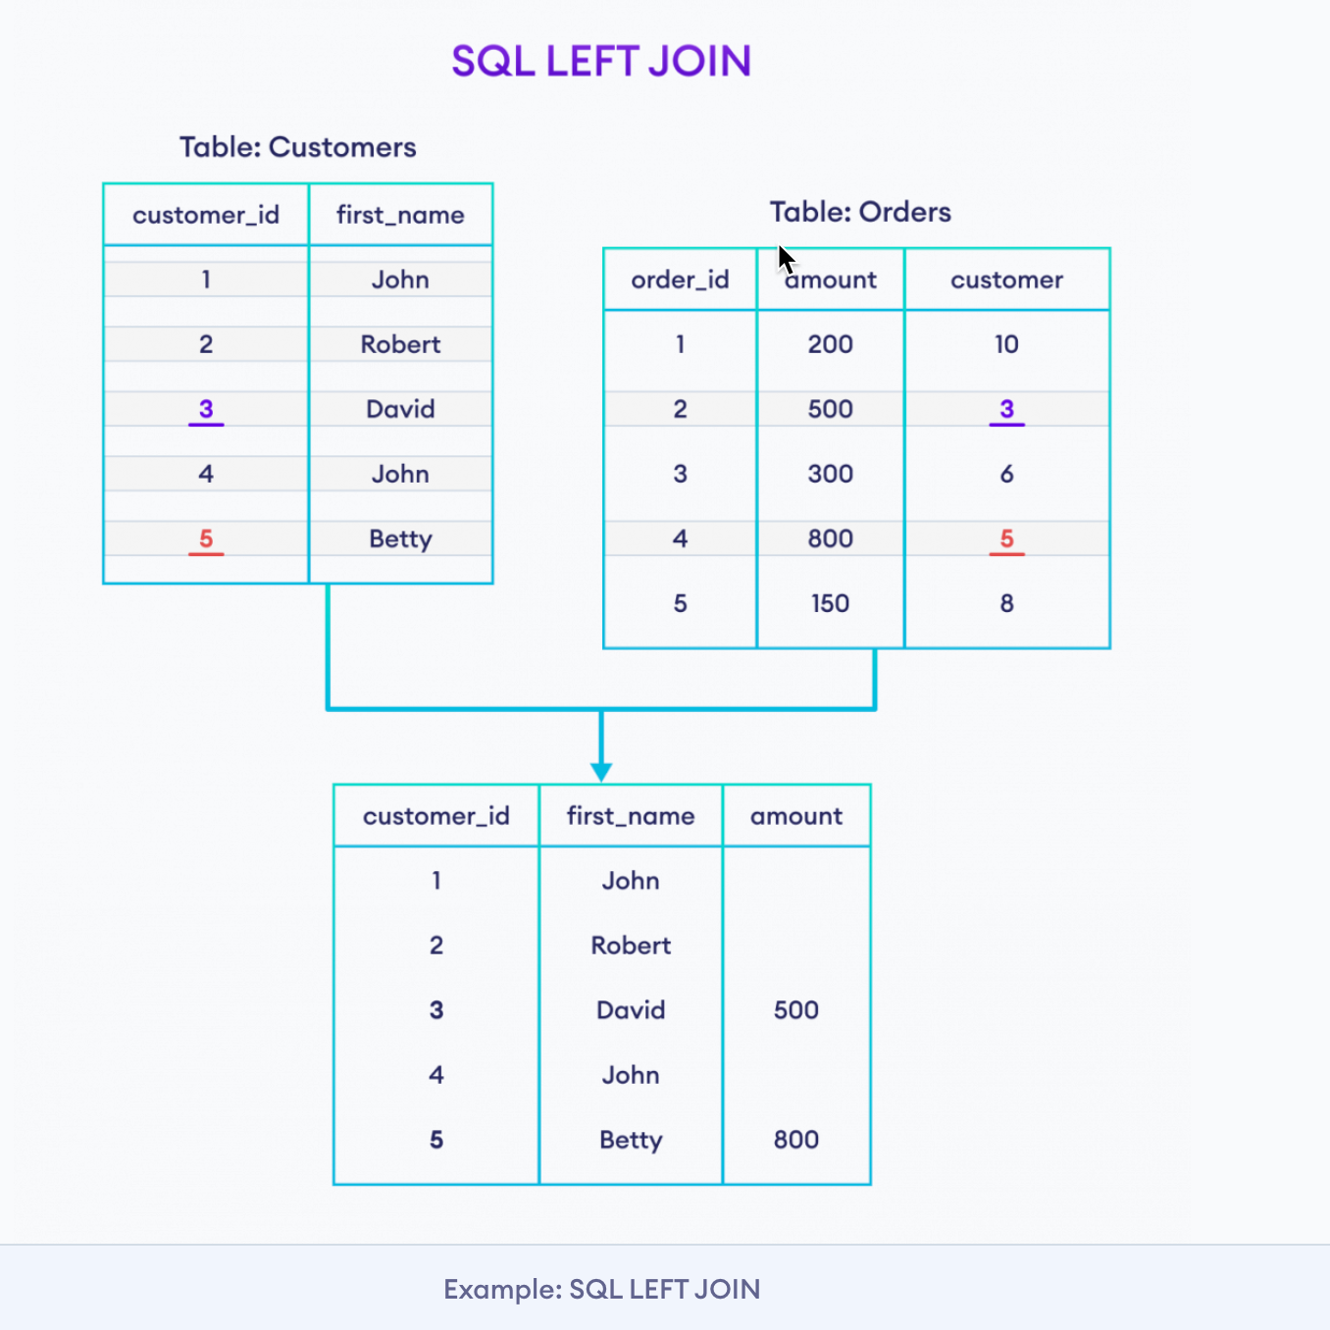

Slide 17
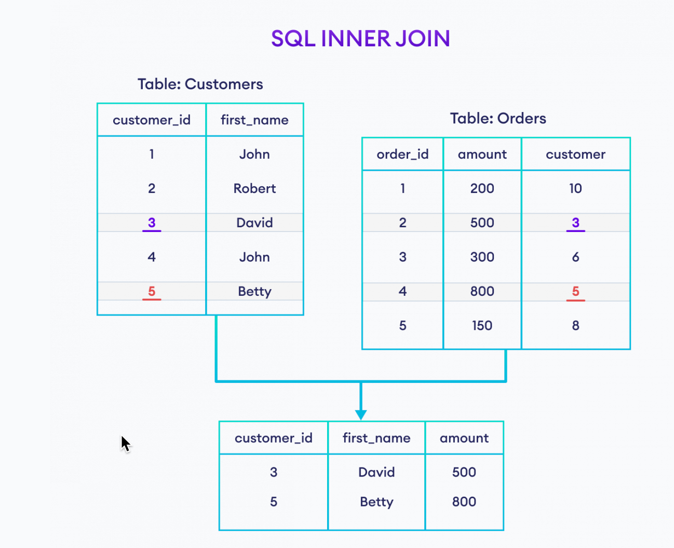

Slide 18
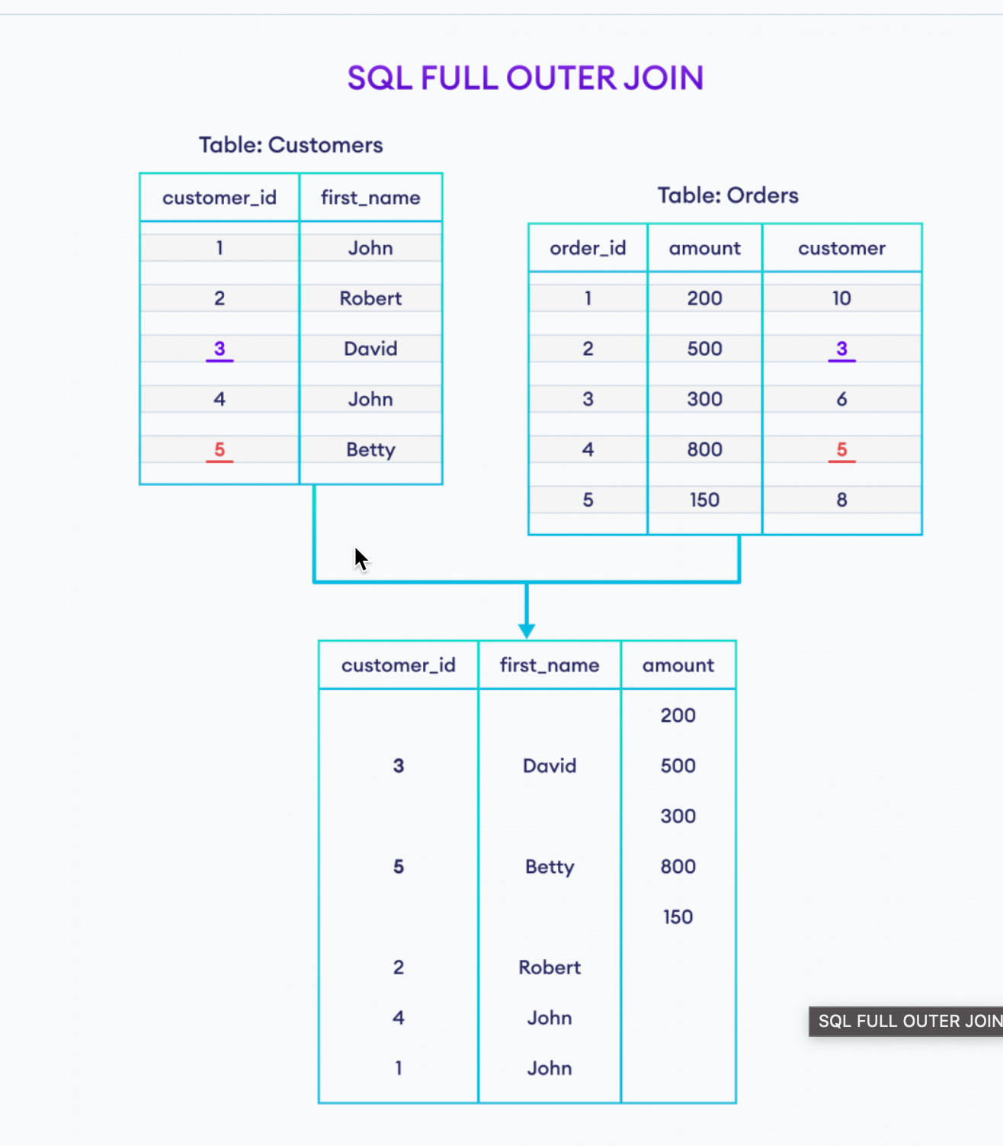

Slide 19
SELECT * FROM
Customers LEFT JOIN Orders
ON
Customers.customer_id = Orders.customer_id;

